Slide 1




MODULE 5.4 · CARE-AI WORKSHOP | Edge AI
Multimodal Edge AI for Autonomous Response
Combined case study: Cybersecurity, Edge AI and Autonomous Driving
Notebooks 01 – 04
Data Synchronization → Multimodal Model → Real-Time Inference → Autonomous Response
https://forms.gle/4Y8YR9WWBiNJfZqd9
MODULE 5.4
Notes:
Module 5.4 combines three threads: automotive cybersecurity, edge AI, and autonomous driving. The four notebooks form one pipeline: synchronize and label the data, train the detector, run it live, then let it act.

Slide 2

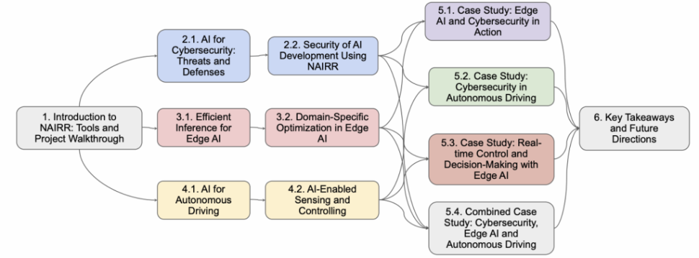



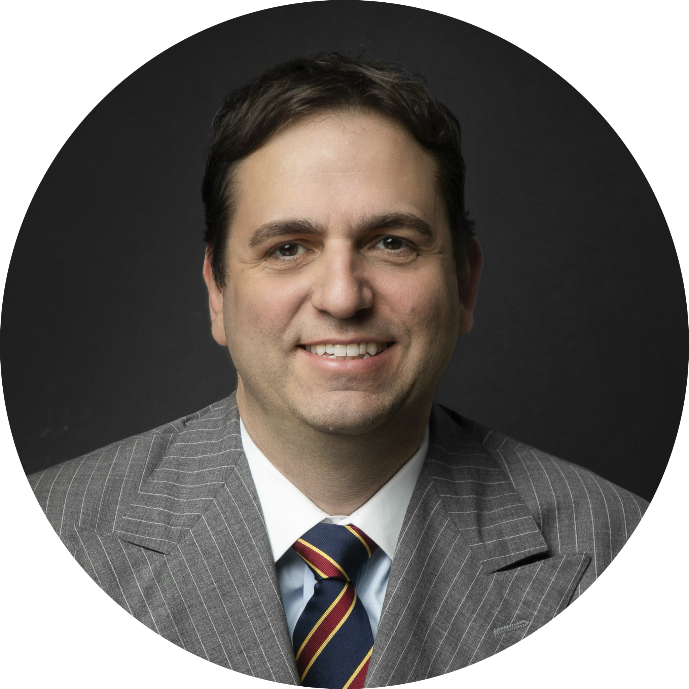

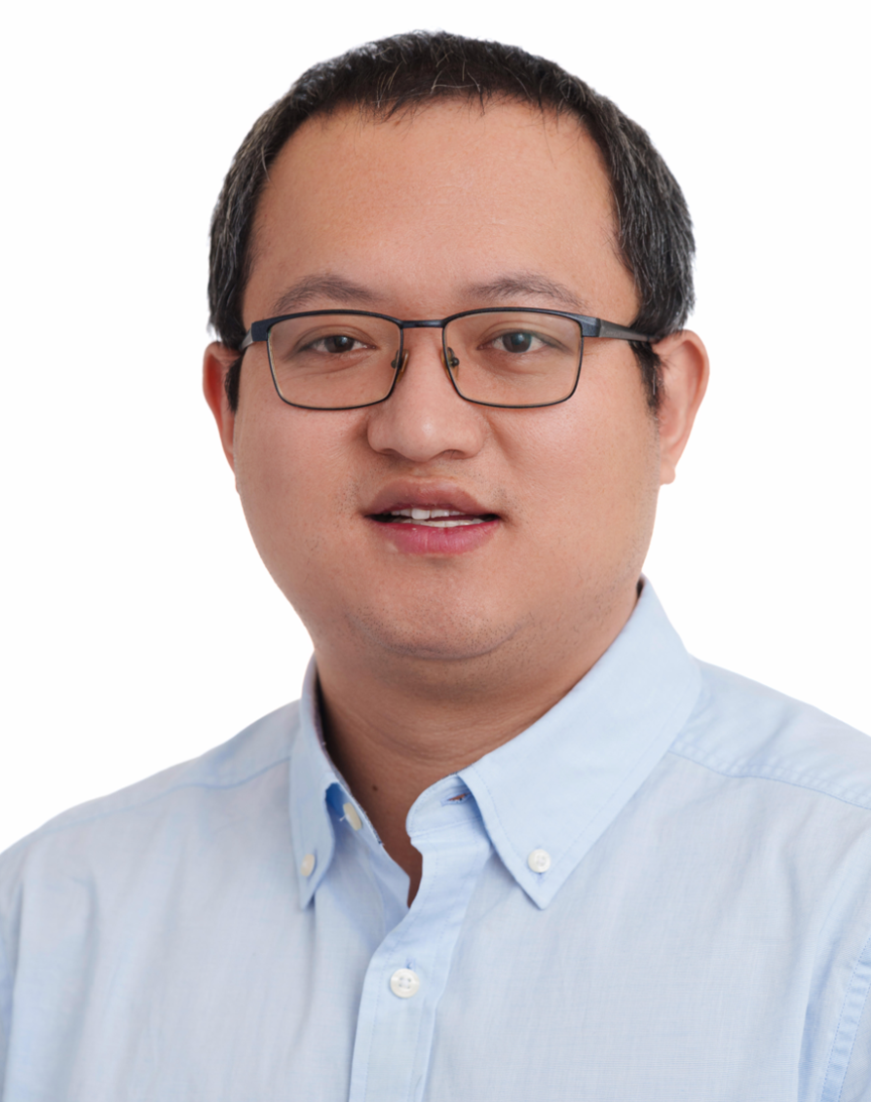






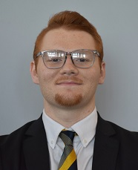














NAIRR CARE-AI Workshop
OU x WPI
PIs
Call to action for cybersecurity faculty and SFS PIs
Co-PIs
Graduate Students
INTRO

Slide 3
AGENDA
What we'll cover today
01
Data Synchronization & Preprocessing
Two async streams → one aligned, labeled table
02
Multimodal Edge AI Model
Dual-branch network, attention fusion, focal loss
03
Real-Time Inference & Alerts
Streaming loop, confidence gating, alert cooldown
04
Autonomous Response Simulation
Decision engine, speed control, comms isolation, system recovery
05
Wrap-up & Hands-On Notebooks
Exercises, checkpoints, Q&A
AGENDA
Notes:
Four notebooks, one pipeline. Each section consumes the artifact the previous one wrote, so the order matters.

Slide 4
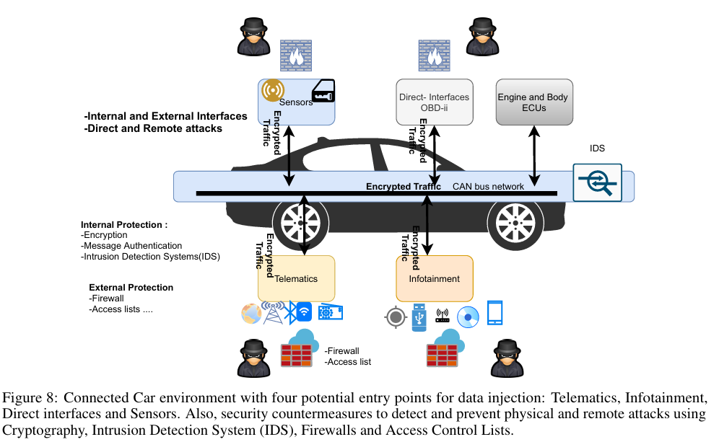
1 · REAL SCENARIO
When a network attack becomes a physical one
How it unfolded
Reached over the cellular network from ~16 km away
Entry point: an open port 6667 on the Uconnect head unit
Head-unit firmware rewritten to gain CAN bus access
Then: brakes, transmission, engine kill — at highway speed
Aftermath
1.4 million vehicles recalled — the first product recall ever caused by a cybersecurity vulnerability.
2014 Jeep Cherokee · Miller & Valasek, Black Hat USA 2015
Aliwa, Emad, et al. "Cyberattacks and countermeasures for in-vehicle networks." ACM computing surveys (CSUR) 54.1 (2021): 1-37.
PART 1 · REAL SCENARIO
Notes:
This is the canonical example of the module's core claim. The attack arrived on the network surface and manifested on the physical surface. A network-only monitor sees traffic on port 6667 but cannot tell whether it mattered; a telemetry-only monitor sees the transmission drop out and reads it as a fault. Only the correlation identifies it as an attack. Worth pausing on the port 6667 coincidence — students will remember it.

Slide 5
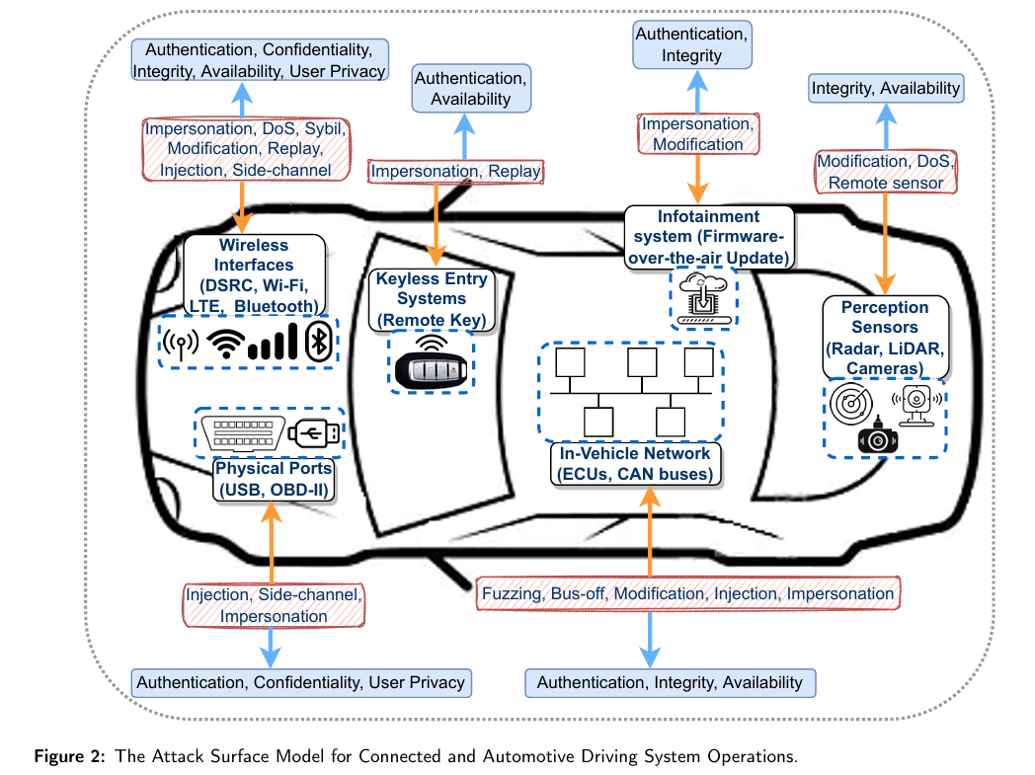
1 · MOTIVATION
The blind spot of single-source monitoring
Two attack surfaces, one vehicle
Physical — brakes, steering, throttle, sensors
Cyber — CAN bus, V2X, telematics, OTA
A capable attacker moves between them
Telemetry only
MISSES CYBER
Sees a hard brake. Cannot separate a failing actuator from an injected CAN frame.
Network only
MISSES PHYSICAL
Sees a traffic burst. Cannot separate an OTA update from an attack worth escalating.
Fused view
SEES BOTH
Speed collapse at the same instant as a packet flood — the correlation is the signal.
Limbasiya, Trupil, et al. "A systematic survey of attack detection and prevention in connected and autonomous vehicles." Vehicular Communications 37 (2022): 100515.
Watch one surface and we inherit the other's blind spot.
PART 1 · MOTIVATION
Notes:
This is the core argument of the module: fusion is not a nice-to-have, it removes a structural blind spot. Notebook 01 injects both anomaly families into one timeline so the model has to separate them.

Slide 6
1 · MOTIVATION
The Workshop 5.4 pipeline end to end
01
02
03
04
Synchronization
& Preprocessing
Multimodal
Edge AI Model
Real-Time
Inference
Autonomous
Response
Align, label,
normalize
Dual-branch net,
attention fusion
Streaming loop,
confidence gating
Decision engine,
vehicle actuation
combined_dataset.csv
best_improved_model.pth
alerts_log.csv
response_log.csv
Contract between stages: each notebook consumes the artifact the previous one wrote. Run 01 → 04 in order — the feature order and scaler fitted in Notebook 01 must match what Notebook 03 sees at inference time.
PART 1 · MOTIVATION
Notes:
Emphasize the contract: a mismatch in feature order between notebooks is the single most common failure students hit.

Slide 7
MODULE 5.4 · TOPIC 1
Data Synchronization & Preprocessing

Slide 8
PART 1 · NOTEBOOK 01
Data Synchronization & Preprocessing
Objective
01
Turn two unsynchronized, differently-shaped streams into one labeled feature table an edge model can train on.
Learning goals
Why fusion is hard: rate, format and precision all differ
Synchronize streams with a bounded-tolerance rule
Repair, encode and scale each modality on its own terms
Produce a balanced, leakage-aware dataset
≈ 45 minutes · 01_data_fusion_and_preprocessing.ipynb
PART 1 · DATA SYNCHRONIZATION

Slide 9
1 · METHOD
Where do we fuse?
EARLY
LATE
HYBRID
Feature-level
Decision-level
Mixed
Concatenate features into one vector, train a single model.
One model per modality, combine their outputs.
Per-modality encoders, then a shared head.
+ Cheapest; learns cross-modal interaction.
− Needs aligned timestamps.
+ Robust to a missing modality.
− Cross-modal correlation is lost.
+ Keeps structure and cross-modal learning.
− More parameters to tune.
This workshop: hybrid in the model, early in the data. Notebook 01 builds one aligned table; Notebook 02 keeps a branch per modality and merges through attention.
PART 1 · DATA SYNCHRONIZATION

Slide 10
1.1 · SOURCES
Two streams, two shapes
Vehicle telemetry
Network traffic log
Records
3 000 over 90 minutes
3 000 over 90 minutes
Cadence
Regular, ≈ 1.8 s apart
Irregular, event-driven
Types
Continuous + one ordinal
Continuous + categorical
Missing
2 % — sensor dropouts
1 % — capture gaps
Repair
Linear interpolation
Zero-fill
Prefix
veh_
net_
Design decision: the modalities are repaired differently on purpose — interpolating a dropped packet count would invent traffic that never existed.
PART 1 · DATA SYNCHRONIZATION
Notes:
The asymmetric imputation rule is a good discussion prompt: ask the room why zero-fill is right for network and wrong for speed.

Slide 11
1 · MOTIVATION
What the model has to separate
Notebook 01 injects two anomaly families into the fused timeline — every pattern below is generated by code we will read and edit.
LABEL 1
Physical anomaly
LABEL 2
Network anomaly
Excessive speed
120–200 km/h
Packet flood
2 000–8 000 packets
Extreme acceleration
±10 m/s² step
Unusual port
4444, 31337, 1337 …
Dangerous proximity
obstacle < 1.5 m
Data exfiltration
100–500 KB, few packets
Erratic behavior
speed + accel + brake
Port scanning
tiny packets, ports < 1024
Sensor failure
distance 200–500 m
Protocol anomaly
unseen code + burst
PART 1 · MOTIVATION
Notes:
Point out that these injections define the label semantics. If a student changes an injection range, the class boundary moves and the Part 2 metrics move with it.

Slide 12
1.2 · SCHEMA
The 12 features the model will see
6 PHYSICAL
6 NETWORK
veh_speed
km/h
net_protocol_encoded
TCP·UDP·ICMP
veh_acceleration
Δ speed
net_packet_count
per flow
veh_distance_to_obstacle
metres
net_bytes_transferred
bytes
veh_gps_lat
route
net_port
known / high
veh_gps_lon
route
net_src_ip_hash
hash mod 10 000
veh_brake_status
0 / 1 / 2
net_dst_ip_hash
hash mod 10 000
Hashing IPs is a shortcut, not a feature. It makes the column numeric but destroys ordering and subnet structure — and Python's hash is salted per process.
PART 1 · DATA SYNCHRONIZATION
Notes:
The IP hash caveat is worth stating out loud — students often carry this pattern into real projects. PYTHONHASHSEED makes it non-reproducible across runs.

Slide 13
1.4 · PREPROCESSING
Four repairs before anything can be fused
01
Standardize timestamps
Until both clocks share a type and a resolution, no matching rule can run.
02
Handle missing values
Telemetry: interpolate. Network: fill with 0 — a capture gap means no traffic observed.
03
Encode categoricals
protocol → LabelEncoder, IPs → hash. Only six numeric net_ columns survive.
04
Namespace the columns
Notebook 02 selects branches purely by prefix — the naming convention is load-bearing.
PART 1 · DATA SYNCHRONIZATION
Notes:
Step 4 sounds cosmetic but drives Notebook 02's branch selection: [c for c in df.columns if c.startswith('veh_')].

Slide 14
1.5 · SYNCHRONIZATION
Nearest-neighbour matching with a tolerance
Telemetry is the reference grid because it is regular. For each telemetry row, take the network row with the smallest |Δt| and keep the pair only if |Δt| ≤ 5 s.
regular, ≈ 1.8 s
veh_
net_
irregular, event-driven
Δt > 5 s → dropped
Tolerance is a knob
Reuse is allowed
Keep the residual
Too tight throws rows away; too loose pairs events that never co-occurred.
One network record can match several telemetry rows, inflating correlation.
time_diff_seconds is stored, so fusion quality stays auditable.
PART 1 · DATA SYNCHRONIZATION
Notes:
The reference-grid choice matters: telemetry is regular, so it anchors. The O(n·m) loop in the notebook is fine at 3 000 rows and will not survive a real fleet — mention pandas merge_asof as the production answer.

Slide 15
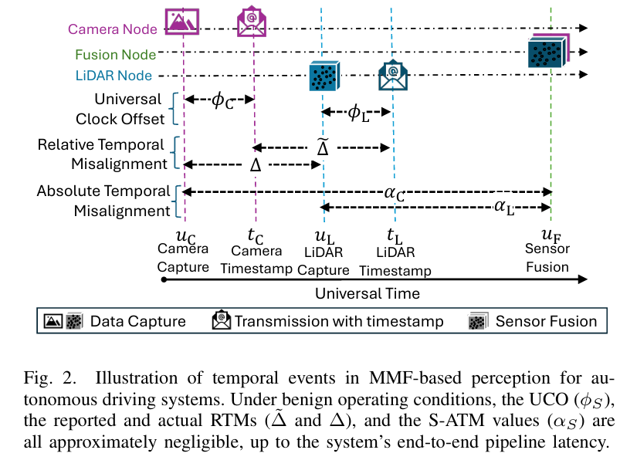
1.5 · SYNCHRONIZATION
Matching on timestamps is an attack surface
What this adds
Capture time (u) and timestamp (t) are different instants
Our |Δt| ≤ 5 s is measured on t, never on u
The clock offset φ sits between them, unobserved
Why it matters
A pair can be inside tolerance and still semantically wrong
Whoever controls timestamps controls what gets paired
Same rule ships in production — ROS 2 ApproximateTimeSynchronizer
Shahriar et al., "Temporal Misalignment Attacks against Multimodal Perception in Autonomous Driving", arXiv 2507.09095
PART 1 · DATA SYNCHRONIZATION
Notes:
The reference-grid choice matters: telemetry is regular, so it anchors. The O(n·m) loop in the notebook is fine at 3 000 rows and will not survive a real fleet — mention pandas merge_asof as the production answer.

Slide 16
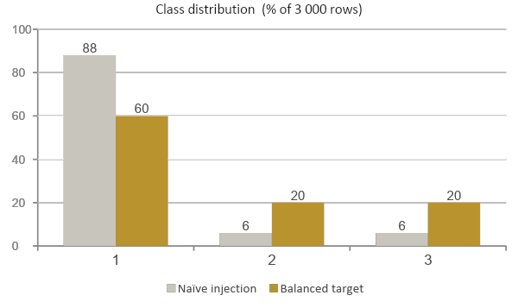
1.6 · LABELS
Injecting anomalies, then balancing the classes
Labels are not observed — they are created by injecting patterns into random rows, then rewriting the affected features so the label is learnable.
Why rebalance
At 88 / 6 / 6, always-Normal scores 88 % and detects nothing
What it costs
Real traffic is nowhere near 40 % anomalous
Accuracy is optimistic by construction
1: Normal 2: Physical 3:Network
PART 1 · DATA SYNCHRONIZATION

Slide 17
1.7 · SCALING
Normalization — and the leakage trap
StandardScaler maps every numeric feature to mean ≈ 0, std ≈ 1, so packet counts in the thousands stop dominating a speed in the tens.
WHAT NB 01 DOES
WHY IT MATTERS
Fits one scaler on the whole fused table
Transforms every numeric column
Writes scaled values into the CSV
Fitting before the split leaks test statistics
Notebook 02 re-fits per branch after splitting
In production the scaler ships with the model
The rule to remember
fit on train only, transform everywhere else — and for time-ordered data, split by time, not at random.
PART 1 · DATA SYNCHRONIZATION
Notes:
Both notebooks use a stratified random split. For a temporal dataset that is optimistic; say so, and point at it as the first thing a student should change in their own project.

Slide 18
1.8 · EDA
What to look for in the fusion dashboard
1
Correlation matrix
2
Anomalies over time
Look for near-zero cross-modal correlation — fusion is adding information, not repeating it.
Injection is uniform by design, so visible bursts mean sampling introduced structure.
3
Speed × packet count
4
Class distribution
If the classes overlap completely in 2-D, the model must lean on the other ten features.
Expect 60 / 20 / 20. Drift means injection collided with dropped rows.
Each panel tests an assumption the Part 2 model depends on.
PART 1 · DATA SYNCHRONIZATION

Slide 19
1.9 · OUTPUT
combined_dataset.csv
3 000
12
3
90 min
≤ 5 s
fused rows
model features
classes
time span
tolerance
Column order on disk
timestamp, label,
veh_acceleration, veh_brake_status, veh_distance_to_obstacle, veh_gps_lat, veh_gps_lon, veh_speed,
net_bytes_transferred, net_dst_ip_hash, net_packet_count, net_port, net_protocol_encoded, net_src_ip_hash,
time_diff_seconds
Checkpoint before Part 2
Row count near 3 000
Labels near 60 / 20 / 20
No NaNs; completeness 100 %
PART 1 · DATA SYNCHRONIZATION
Notes:
If a student's row count collapses, the usual cause is regenerating one stream with a different duration so the two timelines no longer overlap.

Slide 20
1.10 · HANDS-ON
Notebook 01 — what you'll do
Generate both streams, inspect their raw shapes
Questions worth answering
RUN
At what tolerance does quality degrade faster than coverage improves?
Which feature would you drop first, and why?
If the network stream stopped, would the model notice?
Preprocess each modality with its own repair rule
RUN
Change the tolerance, watch the row count move
EDIT
Change the 60 / 20 / 20 target, re-read the report
EDIT
Add a feature, justify which branch it belongs to
WRITE
Exit criterion: combined_dataset.csv exists, has no missing values, and its labels land near 60 / 20 / 20.
PART 1 · DATA SYNCHRONIZATION

Slide 21
MODULE 5.4 · TOPIC 2
Multimodal Edge AI Model

Slide 22
PART 2 · NOTEBOOK 02
Multimodal Edge AI Model
Objective
02
Train a dual-branch network that reads both modalities, fuses them under attention, and classifies every timestamp into three classes.
Learning goals
Design per-modality encoders and an attention-gated head
Train under imbalance with focal loss and class weights
Read a per-class confusion matrix, not one accuracy number
Reason about parameter budget, latency and export format
≈ 45 minutes · 02_multimodal_edge_ai_model.ipynb
PART 2 · MULTIMODAL MODEL

Slide 23
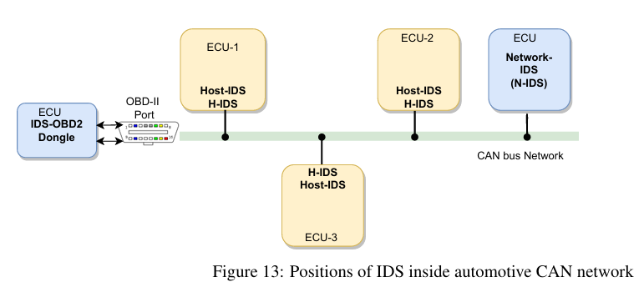
2 · REAL SCENARIO
Why this has to run on the vehicle
No longer optional
Mandatory for all new vehicle types since July 2022
Extended to all newly produced vehicles in July 2024
60+ contracting countries: EU, Japan, South Korea, UK
No CSMS certificate, no type approval, no sale
Your only three options
Host-IDS inside each ECU
Network-IDS watching the bus
A dongle on the OBD-II port
Aliwa, Emad, et al. "Cyberattacks and countermeasures for in-vehicle networks." ACM computing surveys (CSUR) 54.1 (2021): 1-37.
All three live on the vehicle. No cloud round trip, no spare gigabyte — which is why the next slides count parameters.
PART 2 · REAL SCENARIO
Notes:
Be precise here: R155 is process- and governance-focused. It requires a certified Cybersecurity Management System and evidence of detection and response capability over the vehicle lifecycle — it does NOT prescribe an intrusion detection system or any specific technology. ISO/SAE 21434 is the engineering standard commonly used to implement it. The honest framing is: the regulation creates the demand, and the embedded resource limits create the difficulty. That gap is exactly what Part 2 is about.

Slide 24
2.1 · DESIGN
Three goals that pull against each other
1
2
3
Accuracy
Edge readiness
Interpretability
Separate three classes that overlap in any single modality.
The model runs on an ECU beside the control stack. Memory and latency are hard limits.
A safety response must be explainable. Which modality drove this alert?
Lever: Deeper branches, richer fusion
Lever: Fewer parameters, INT8
Lever: Attention weights, per-class metrics
The honest framing
we cannot maximize all three. This notebook over-provisions capacity first and treats compression as a later step, so we measure what accuracy costs in megabytes and milliseconds.
PART 2 · MULTIMODAL MODEL

Slide 25
2.2 · ARCHITECTURE
Dual-branch encoder with attention-gated fusion
Vehicle branch
Network branch
Fusion head
Linear+ReLU+BN ×6
Linear+ReLU+BN ×6
Linear+ReLU+BN ×6 + out
veh_ (6)
net_ (6)
gated (32)
512 → 256 → 128
512 → 256 → 128
512 → 256 → 128
64 → 32 → 16
64 → 32 → 16
64 → 32 → 16
0 Normal
Attention gate
32→64→tanh→32→softmax
logits (3)
1 Physical
concat → 32-d joint vector
2 Network
⊙ element-wise
Dropout is scaled by 0.7 and tapers with depth — heavy where the layers are wide, almost none where the representation is already compressed.
PART 2 · MULTIMODAL MODEL
Notes:
Note the shape: each branch squeezes 6 inputs up to 512 and back down to 16. That expansion is where almost all the parameters live, and it is the first thing to cut if the model has to shrink.

Slide 26
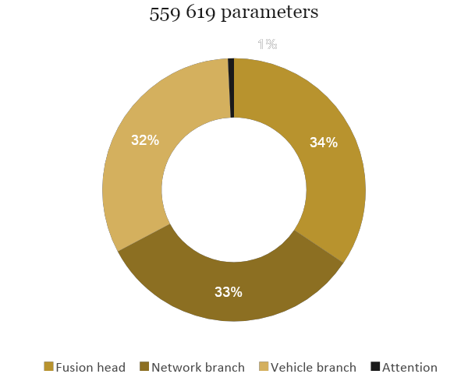
2.3 · BUDGET
Where the parameters actually go
Layer-group breakdown
Group
Params
Vehicle branch
180 688
Network branch
185 296
Attention gate
4 192
Fusion head
194 051
Total
559 619
2.13 MB
1.07 MB
0.53 MB
FP32
FP16
INT8
Read the code, not the comment. The docstring claims ~3.4 M parameters; the layer stack totals 559 619. Counting them is the exercise.
PART 2 · MULTIMODAL MODEL
Notes:
Counts assume 6 vehicle and 6 network input features and include BatchNorm affine parameters. Have students print sum(p.numel() for p in model.parameters()) and compare with the docstring — a good habit to build.

Slide 27
2.4 · FUSION
What the attention gate actually does
1
Concatenate
h = [ h_veh ; h_net ]
Two 16-d encodings become one 32-d vector: dims 0–15 physical, 16–31 network.
2
Score
a = softmax(W₂·tanh(W₁h))
A two-layer MLP scores every dimension. Softmax makes the 32 scores sum to 1.
3
Gate
h̃ = h ⊙ a
Dimensions the gate scores low are suppressed before the classifier sees them.
Worth the 4 192 parameters
Caveat to raise
The model learns which modality to trust per class, instead of having it hard-coded.
Softmax forces the 32 dims to compete — a sigmoid gate would let both modalities be loud at once.
PART 2 · MULTIMODAL MODEL
Notes:
Good extension exercise: swap softmax for sigmoid and compare per-class recall. It usually helps on the hybrid cases where both modalities are anomalous.

Slide 28
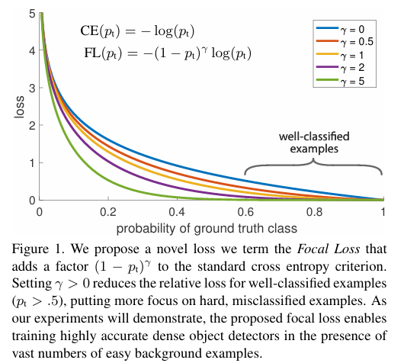
2.4 · FUSION
Why focal loss
γ = 0 is plain cross-entropy — the top curve
Higher γ flattens the right tail: easy examples stop contributing gradient
γ = 2.0 (our setting): p_t = 0.9 keeps 1 % of its loss, p_t = 0.1 keeps 81 %
Hard examples get ~80× the relative weight
Lin et al., "Focal Loss for Dense Object Detection," ICCV 2017. arXiv:1708.02002
PART 2 · MULTIMODAL MODEL
Notes:
Good extension exercise: swap softmax for sigmoid and compare per-class recall. It usually helps on the hybrid cases where both modalities are anomalous.

Slide 29
2.5 · OBJECTIVE
Training under an imbalanced objective
FL(p_t) = − α_t · (1 − p_t)^γ · log(p_t)
α_t
(1 − p_t)^γ
log(p_t)
Class weight
Focusing term
Cross-entropy core
[ 0.6, 1.4, 1.0 ]
γ = 2.0
50 / 50 mix
Physical anomalies up-weighted 1.4× — hardest class, most safety-relevant.
An example already right at p = 0.9 gives 1 % of its usual gradient.
Half focal, half weighted CE with label smoothing 0.05.
Two knobs pointing the same way. α re-weights by class, γ by difficulty, and the data was already rebalanced. Stacking all three can over-correct.
PART 2 · MULTIMODAL MODEL
Notes:
The notebook sets gamma twice (1.5 then 2.0) and weight_decay twice (1e-4 then 1e-3); the second assignment wins in both cases. Worth showing as a real-code hazard.

Slide 30
2.6 · TRAINING
The training recipe, and what each knob buys
Knob
Setting
Why it is there
Optimizer
AdamW
Decoupled weight decay
Learning rate
3e-4
Stable across a BatchNorm-heavy stack
Weight decay
1e-3
Set twice — the later value is what runs
Batch size
32
Noisy but useful BatchNorm statistics
Scheduler
ReduceLROnPlateau
factor 0.7, patience 20 — reacts to loss
Early stopping
patience 40
Best checkpoint restored, not the last
Validation
20 % of train
Carved out after the split; test stays clean
Watch the gap between train and validation accuracy, not either curve alone.
PART 2 · MULTIMODAL MODEL

Slide 31
2.7 · EVALUATION
Read the matrix, not the headline number
Predicted
Normal
Physical
Network
What the notebook reports
Accuracy, macro precision, macro recall
Full classification report + per-class F1 chart
How to read it here
Recall is the safety number, precision the nuisance number
Always-Normal already scores 0.60 on this data
Recalibrate the threshold before Part 3
True
Normal
✓
false
alarm
false
alarm
Physical
missed
fault
✓
confused
Network
missed
attack
confused
✓
The first column is the dangerous one: an anomaly predicted Normal means Part 4 never fires a response.
PART 2 · MULTIMODAL MODEL
Notes:
Emphasize the asymmetry of the error types. In a safety system, a missed physical fault and a false alarm are not equally costly, and a single accuracy number hides both.

Slide 32
2.8 · DEPLOYMENT
From checkpoint to edge artifact
Save
Export
Compress
best_improved_model.pth
improved_multimodal_net.onnx
FP16 / INT8
Best-validation checkpoint plus feature order and scalers. The model alone cannot reproduce inference.
ONNX decouples the model from PyTorch so an automotive runtime can execute it.
2.13 MB → ~0.53 MB. Re-measure per-class recall — rare classes degrade first.
Handoff to Part 3
What carries forward
Real-time inference reloads all three artifacts and replays the same preprocessing on a live stream — any drift between them shows up as silent misclassification.
PART 2 · DEPLOYMENT
Notes:
Emphasize the asymmetry of the error types. In a safety system, a missed physical fault and a false alarm are not equally costly, and a single accuracy number hides both.

Slide 33
MODULE 5.4 · TOPIC 3
Real-Time Inference & Alerts
Real-time anomaly detection with intelligent alert management for autonomous vehicles.

Slide 34
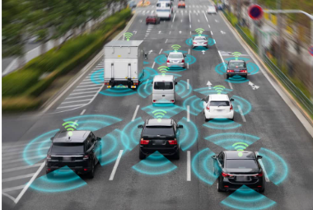
PRELIMINARY
Edge Devices in Autonomous Vehicles
A connected vehicle senses the road non-stop such as cameras, radar, LiDAR, GPS, and internal telemetry.
Threats come in two forms: a physical fault (brakes, tires, sensors) or a cyber attack on the vehicle network.
There is no time to send data to the cloud — detection and response must happen on the vehicle, in real time.
Connected vehicles sense the road continuously
PART 3 · Real-Time Inference & Alerts

Slide 35




PRELIMINARY
Why real-time matters for autonomous systems
Safety is immediate
A vehicle cannot wait to analyze data later including braking, steering, and sensor decisions happen in real time.
Threats are both cyber and physical
An anomaly may be a network attack, or a failing physical component. Both must be caught as they happen.
The edge cannot wait for the cloud
Connectivity is intermittent and round-trips are slow. Attack traffic can grow very fast, so the vehicle cannot store data and analyze it later — inference runs on the edge device itself.
Action must be actionable
Raw detections are not enough; the system must turn them into clear, prioritized alerts a human can act on.
PART 3 · Real-Time Inference & Alerts

Slide 36
PRELIMINARY
Batch Thinking vs. Stream Thinking
Most ML training is batch work. Deployment to a live system flips almost every assumption.
Batch (training)
Stream (deployment)
Data
Bounded — a file with an end
Unbounded — it never stops arriving
Latency
Minutes to hours are fine
Milliseconds to seconds, per item
Computation
Recompute from scratch anytime
Incremental. update state per event
Order & time
Shuffle freely; time is a column
Event time matters; late data is real
Failure
Rerun the job
Must keep up. backlog compounds
PART 3 · Real-Time Inference & Alerts

Slide 37


HOW IT WORKS
Synchronizing the Streams
In topic 1, we fused two modalities offline, with all timestamps in hand. Live, the two streams arrive separately, at different rates.
Vehicle sensor stream (fast, regular — speed, accel, CAN)
WHAT CAN GO WRONG LIVE
Rate mismatch: One modality has hundreds of readings per window, the other may have three.
Clock skew : Sensors and network capture timestamp events on different clocks.
Gaps & late data: A window may close with one modality missing; the engine still has to answer.
Network traffic stream (bursty, irregular — packets, flows)
Aligned windows → one fused feature vector each
t0 – t1
t1 – t2
t2 – t3
t3 – t4
Practical rule: aggregate each modality per window (means, counts, rates), then fuse.
PART 3 · Real-Time Inference & Alerts

Slide 38




HOW IT WORKS
The real-time inference pipeline
Continuous sensor and network data is turned into prioritized, actionable alerts — as events happen, on the vehicle.
Streaming Data
Live Inference
Alert Decision
Monitoring
Sensors & traffic arrive continuously
classify each sample in real time
confidence, cooldown,severity
track surface alerts
Data never stops- the system must keep up.
Every detection is filtered before it becomes an alert to reduce the false alarms.
The pipeline runs locally, so response happens in milliseconds.
PART 3 · Real-Time Inference & Alerts

Slide 39
HOW IT WORKS
Traffic Windowing
Real-time systems use windows to split continuous data streams into small chunks for analysis. The window type affects how quickly the system detects changes, how much context it captures, and how much computation it needs.
Session Windows:
No fixed size at all. A window stays open while events keep arriving and closes after an idle gap longer than a G.
one window per burst of activity
idle gap > G → window closes
time
Advantages
Matches traffic semantics. A burst becomes one window.
Quiet periods cost nothing.
Window count adapts to activity.
Disadvantages
Window length and closing time are unpredictable. Detection latency and memory are no longer bounded by design.
The gap parameter G constant must be tuned.
Sustained traffic can hold a window open indefinitely.
PART 3 · Real-Time Inference & Alerts

Slide 40
HOW IT WORKS
Traffic Windowing
Count-Based Windows:
Close after every N events instead of every Δt seconds. Each window carries the same amount of evidence, but its duration varies with traffic rate.
N = 6 events per window — equal evidence, unequal duration
time
Advantages
Equal evidence per window.
Feature statistics (means, distributions) stay comparable across rate swings.
Robust default for sources whose rate varies by orders of magnitude.
Disadvantages
Detection latency becomes traffic-dependent.
Duration-based features (rates, inter-arrival times) need care.
A flood closes windows extremely fast.
PART 3 · Real-Time Inference & Alerts

Slide 41
HOW IT WORKS
Cooldown and severity
Cooldown: reducing repeats
Severity: ranking what matters
After an alert fires, the same type is muted briefly.
CRITICAL
Physical anomaly: the car itself can cause harm
Stops one event from becoming a stream of alarms.
HIGH
Network anomaly: an attack in progress
Normal status is reported only occasionally.
INFO
Normal operation: routine health signal
Priority follows safety impact — in a vehicle, a physical fault outranks a network attack.
PART 3 · Real-Time Inference & Alerts

Slide 42
HOW IT WORKS
Monitoring a Safety-critical Live System
A deployed model can fail quietly. In the field there are no labels, so the system watches indirect signs of trouble.
Speed
Throughput
Is each decision made within its time budget?
Is the system keeping up with the data rate?
Alert volume
Confidence trend
A sudden flood — or total silence — both signal problems.
Falling confidence can mean the model is drifting.
Key idea: monitoring is part of the system, not an afterthought; especially where safety is on the line.
PART 3 · Real-Time Inference & Alerts

Slide 43
HOW IT WORKS
How The System is Scored
Metric
Definition
What it tells you
Detection latency
t(first alert) − t(anomaly onset)
how many windows pass before the attack is surfaced
False alarms / hour
alerts emitted on the Normal scenario ÷ hours
the cost of confidence set too low
Per-class P / R / F1
computed on labeled replay, per class
Physical and Network are scored separately — a detector can be good at one and blind to the other
Suppression ratio
raw detections → surfaced alerts (e.g., 87 → 4)
what cooldown buys the operator
p95 latency & throughput
from the monitor, during the same replay
correctness numbers only count if the deadline holds
PART 3 · Real-Time Inference & Alerts

Slide 44
HANDS-ON
What You'll Implement
Review Key Ideas
Real-time streaming and continuous data processing.
Confidence-based inference and decision making.
Intelligent alerting: cooldown,severity and false-positive reduction
Analyze
Simulate and process a live sensor +network data stream
Run a live inference engine with confidence-based alerting.
Explore the security alert dashboard and timeline.
PART 3 · Real-Time Inference & Alerts

Slide 45
MODULE 5.4 · TOPIC 4
Autonomous Response Simulation
Autonomous response simulation with decision-making and vehicle control.

Slide 46


The problem
Prevention isn’t enough anymore
Modern vehicles are networks on wheels — dozens of electronic control units, sensors, and external links from a large attack surface. Security is never absolute, so the field is shifting from purely preventing attacks to actively mitigating their impact once they occur.
Traditional: wait for the operations center
Current: respond inside the vehicle
Attack data is shipped to a Vehicle Security Operations Center, analyzed by experts, and a patch is sent back. With huge fleets and terabytes of data per car, high-severity incidents can take days or weeks to resolve.
An response system decides and acts in near-real time. No round-trip to the cloud, no human in the loop for the first move. The vehicle contains the threat itself and returns to a safe state within milliseconds.
Hamad, M., Finkenzeller, A., Kühr, M., Roberts, A., Maennel, O., Prevelakis, V., & Steinhorst, S. (2024). REACT: Autonomous intrusion response system for intelligent vehicles. Computers & Security, 145, 104008.
PART 4 · Autonomous Response Simulation

Slide 47




HOW IT WORKS
Types of Responses
By timing
Proactive preempt: Acts before or as the threat unfolds, anticipating impact
Reactive after detection: Mitigates only once an intrusion is confirmed
By adaptivity
Static fixed mapping: Each alert triggers a pre-set, unchanging countermeasure
Dynamic context-aware: Choice adapts to vehicle state, severity, and past success
By selection
Cost-agnostic: Applies a response without weighing its side effects
Cost-sensitive: Weighs response benefit against its operational cost
By autonomy
Human-in-the-loop: An operator or security center approves the action
Autonomous: The vehicle decides and acts on its own, in real time
Bashendy, May, Ashraf Tantawy, and Abdelkarim Erradi. "Intrusion response systems for cyber-physical systems: A comprehensive survey." Computers & Security 124 (2023): 102984.
PART 4 · Autonomous Response Simulation

Slide 48


HOW IT WORKS
Confidence Threshold
The detector never just says “attack” or “fine”. It outputs a confidence score.
threshold 0.7
0.0
1.0
below — treat as normal / cautious
at or above — act on it
Threshold too low
Threshold too high
Every flicker becomes an alert. The vehicle brakes at shadows — false alarms are themselves a safety hazard, and operators stop trusting the system.
Only in-certain threats get through. Real attacks and faults slip by while confidence climbs. The vehicle reacts too late.
The threshold is the dial between these two. In the hands-on experiment, we will use 0.7.
18
PART 4 · Autonomous Response Simulation

Slide 49



HOW IT WORKS
Decision to Vehicle Action
The response layer continuously tracks the vehicle's state such as speed, target speed, communication status, and active anomalies and translates every decision into a concrete, safe maneuver.
Physical response: Slow the vehicle
Gradual, controlled speed reduction keeps the vehicle stable while a suspected brake or engine fault is active. No abrupt braking and smooth deceleration toward the reduced target.
Network response: Cut the attack surface
Communication systems are isolated and switched to secure protocols. The vehicle keeps driving at near-normal speed; the threat is contained at the network layer instead of the road.
Recovery: Return to normal
When an anomaly duration expires, the system ramps speed back toward the 65 km/h target and restores communications, logging the full response cycle.
PART 4 · Autonomous Response Simulation

Slide 50

HOW IT WORKS
System Architecture
Alert Detection
Decision Engine
Response Executor
System Recovery
Anomaly alerts arrive with type, confidence & duration
Confidence thresholding selects the response protocol
Speed adjustment or communication isolation
Gradual return to normal 65 km/h operation
General four stage architecture for system recovery. Note: Every alert, decision, and action is recorded. So the system's behavior can be analyzed, audited, and improved.
Hamad, M., Finkenzeller, A., Kühr, M., Roberts, A., Maennel, O., Prevelakis, V., & Steinhorst, S. (2024). REACT: Autonomous intrusion response system for intelligent vehicles. Computers & Security, 145, 104008.
PART 4 · Autonomous Response Simulation

Slide 51

HOW IT WORKS
Response Executor
Once a response is chosen, the executor carries it out on the physical vehicle.
Bounded actuation
Containment
Degraded safe mode
Actions stay within safe physical limits — e.g. a rate-limited speed reduction, not an abrupt stop. The classic CPS example: cap a car’s speed after a control fault rather than shutting it off.
For a cyber threat, isolate the affected channel and switch to secure/redundant paths so the vehicle keeps operating. Contain the attack surface instead of disabling the function.
The vehicle enters a defined fallback state with explicit limits. An intentional, documented mode, never an unmanaged workaround that hides new risk.
Respond first, recover later. Response is fast and deployed immediately after detection; full recovery is a slower process that follows. The executor’s job is to buy safe time.
Segovia-Ferreira, Mariana, Jose Rubio-Hernan, Ana Cavalli, and Joaquin Garcia-Alfaro. "A survey on cyber-resilience approaches for cyber-physical systems." ACM Computing Surveys 56, no. 8 (2024): 1-37.
PART 4 · Autonomous Response Simulation

Slide 52


HOW IT WORKS
System Recovery
Recovery is the reverse journey: from the degraded safe state back to full nominal operation.
Damage assessment
Resilient state estimation
Restore to nominal
Verify & confirm
Determine the extent which components were touched and from when. Operational logs pin the attack-start time and scope.
Recover the vehicle’s true state even if some sensor inputs were corrupted, so recovery acts on reality, not manipulated data.
Ramp controlled variables back to target and re-enable isolated channels smoothly, not abruptly, to avoid a second disturbance.
Recheck that the system is genuinely safe before declaring normal operation; if the threat persists, loop back to response.
Pisón, Mª Teresa Araúz. "Cybersecurity in model-based control: resilient design and software rejuvenation methods." PhD diss., Universidad de Sevilla, 2025.
PART 4 · Autonomous Response Simulation

Slide 53

HOW IT WORKS
How response & recovery are logged and viewed
Every action the executor and recovery layer take is recorded as a timestamped event. Together these form an audit trail — the record that answers what happened, when, and why, and lets a run be replayed and scored.
Live view
one logged event — who did what, when, why
The state trace (speed, comms, mode over time) plots the response as it unfolds — the timeline chart.
timestamp — when the action fired
Replay
trigger — which alert / anomaly caused it
Because every transition is timestamped, the whole incident replays deterministically for root-cause analysis.
action — what was done (slow, isolate, recover)
Scoring
parameters — magnitude, target, limits applied
Logged events feed the metrics — response time, recovery quality, availability — turning raw activity into a performance grade.
state before / after — speed, comms, mode snapshot
Accountability
outcome — resolved · escalated · ongoing
A tamper-evident trail supports audit and post-incident forensics — evidence of what the autonomous system did and why.
PART 4 · Autonomous Response Simulation

Slide 54
HANDS-ON
What You'll Implement
Review Key Ideas
Autonomous decision-making with confidence-based thresholds.
Vehicle response protocols for cybersecurity and physical threats.
Real-time simulation and performance analysis techniques.
Analyze
Build the decision engine and response executor
Run the full simulation with realistic sparse alerts.
Explore performance analytics and the response timeline.
PART 4 · Autonomous Response Simulation

Slide 55
MODULE 5.4 · CONCLUSION
One pipeline, four notebooks
01
Data Synchronization
Two asynchronous streams became one labeled table — and the tolerance you pick sets coverage and attack surface at the same time.
02
Multimodal Model
A dual-branch encoder with attention-gated fusion: 559,619 parameters, 2.13 MB — small enough to sit beside the control stack.
03
Real-Time Inference
Confidence gating turns a stream of raw predictions into the few alerts that are actually worth acting on.
04
Autonomous Response
Bounded actuation, containment instead of shutdown, and a logged path back to nominal operation.
PART 4 · Autonomous Response Simulation

Slide 56
Acknowledgements
NSF NAIRR-Nat AI Research Resource (NAIRR) Awards OAC-2528533 and OAC-2528534
National Artificial Intelligence Research Resource (NAIRR) Pilot allocation NAIRR250048
Jetstream2 cloud resource supported by the NSF (award NSF-OAC 2005506) at Indiana University
Call to action for cybersecurity faculty and SFS PIs
Adopt one workshop module in a course or REU/SFS training
Send participants to the March 2026 series (virtual)
Co-develop a case study using your datasets or agency partners
Share feedback on the highest-value modules to prioritize packaging
Any opinions, finding, and conclusions or recommendations expressed in this material are those of the author(s) and do no necessarily reflect the views of the National Science Foundation.
Contact: fu@oakland.edu | jdai@wpi.edu
Contact: fu@oakland.edu | jdai@wpi.edu
Notes:
Close by asking the room which module they would adopt first, and what barrier (accounts, time, staffing, compute) is most acute.
https://access-ci.org/

Slide 57

THE END
Questions?
https://forms.gle/NkrcSjiWub5F1qs68

